Slide 1


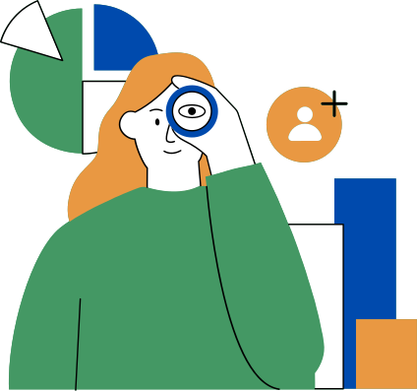


COnsumer behaviour
by Zulfa Irbah
13/12/2023

Slide 2
What is consumer behaviour?
Consumer behavior refers to the actions and decisions that individuals or households make when they choose, buy, use, and dispose of products or services. It is a multi-stage process influenced by psychological, sociological, and cultural factors.

Slide 3
Consumer behaviour definition by experts
Consumer behaviour is the study of how people buy, what they buy, when they buy and why they buy. (Kotler, 1994)
“The behaviour that consumers display in searching for, purchasing, using, evaluating, and disposing of products and services that they expect will satisfy their needs. (Schiffman, 2007)
A set of activities which involves the purchase and use of goods and services which resulted from the customers’ emotional and mental needs and behavioural responses. (Stallworth,2008)
Consumer buying behaviour “refers to the buying behaviour of final consumers, both individuals and households, who buy goods and services for personal consumption” (Kumar, 2010, p.218).

Slide 4
Why is it important for a marketer
to understand consumer behavior?
Knowing about consumer behavior is crucial because it helps businesses understand the thought processes, preferences, and decision-making processes of their target audience, allowing them to create effective marketing strategies, design innovative products, retain customers, minimize risks, build strong brand relationships, and adapt to changing market trends

Slide 5


Factors Influencing Consumer Behavior:
Psychological Factors
Social Factors
Cultural Factors
Personal Factors
Family
Reference Group
Social Roles
Status in society
Friends
Understanding these social factors is essential for businesses to develop effective marketing strategies and tailor their products to meet the diverse influences on consumer behavior.
Culture
Subculture.
Social class
Cultural values, beliefs, and customs shape individuals' preferences and choices. Understanding these cultural factors is essential for businesses to effectively tailor their marketing strategies and products to different consumer segments, taking into account the diverse influences on consumer behavior.
Occupation
Age and life cycle stage
Economic situation
Lifestyle
Personality and self-concept
By comprehending these factors, businesses can develop more effective marketing strategies, create products that better meet consumer needs, and ultimately improve their competitiveness in the market
motivation
perception
learning
beliefs
Psychological factors play a significant role in shaping consumer behavior, as they influence a consumer's decision-making and purchasing decisions.

Slide 6


Online consumer behaviour
With the rise of e-commerce, understanding online consumer behavior is crucial. Online consumer behavior refers to the process of how consumers make decisions to purchase products in e-commerce. It encompasses various aspects, including information search, product evaluation, purchasing decisions, and post-purchase evaluations.
Factors such as website usability, convenience, easy access across devices, online reviews, and social media influence play a significant role in shaping consumers' decisions in the digital age.
Understanding these factors is essential for businesses to create effective e-commerce strategies, improve customer satisfaction, and enhance the overall online shopping experience

Slide 7
Let’s take a look at some cases of consumer behavior and how to identify it:
Product preferences: Observe people's choices of products in stores or online. This can help you identify their preferences for brands, features, or prices.
Purchasing patterns: Observe the buying behavior of individuals, such as their tendency to impulse buy or compare prices before making a purchase.
Shopping frequency: Notice how often people visit stores or websites to make purchases. This can indicate their level of engagement with the product or service
In-store behavior: Observe customers' interactions with products, such as how they touch, feel, or try out items before making a purchase. This can help you understand their decision-making process and preferences
Social media engagement: Monitor how people interact with a brand's social media content, such as likes, comments, and shares. This can provide insights into their attitudes and opinions about the brand

Slide 8
References:
Koltler, P. (1994) “Marketing Management –Analysis, Planning, Implementation and Control”, Prencice-Hall Inc.
Kumar, P. (2010) “Marketing of Hospitality & Tourism Services” Tata McGraw-Hill Education
Schiffman, L., Hansen H. and Kanuk L. (2007) “Consumer Behaviour: A European Outlook”, London: Pearson Education
Stallworth, P. (2008) “Consumer behaviour and marketing strategic”, online, pp.9.

Slide 9

Thank you!!!

